Slide 1
Liquid propulsion
Week 8

Slide 2
Presentation Layout
Achievements made
Improved PID design
Purchased fuel tank
Purchased proper bolts
Display sensor values on UI
Work in progress
Modify fuel tank
Acquire components
Finish code and compilation
Implementing circuit

Slide 3
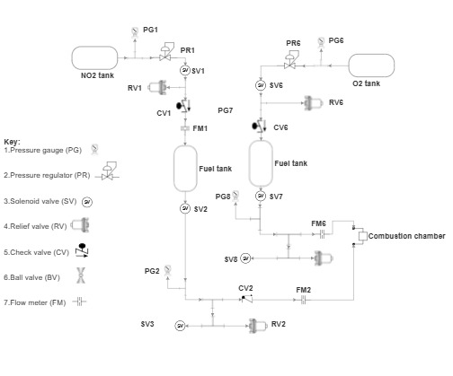
1. Previous PID Design

Slide 4
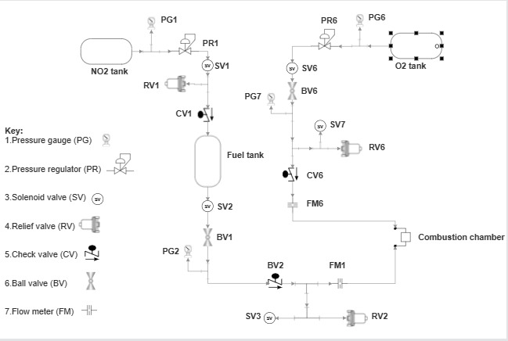
Improved PID Design

Slide 5
Advantages of improved PID
1. Simpler design (5 components eliminated between CV6 and FM6)
2. Quicker and robust setup
3. Less costly
4. Closer representation of final firing test

Slide 6
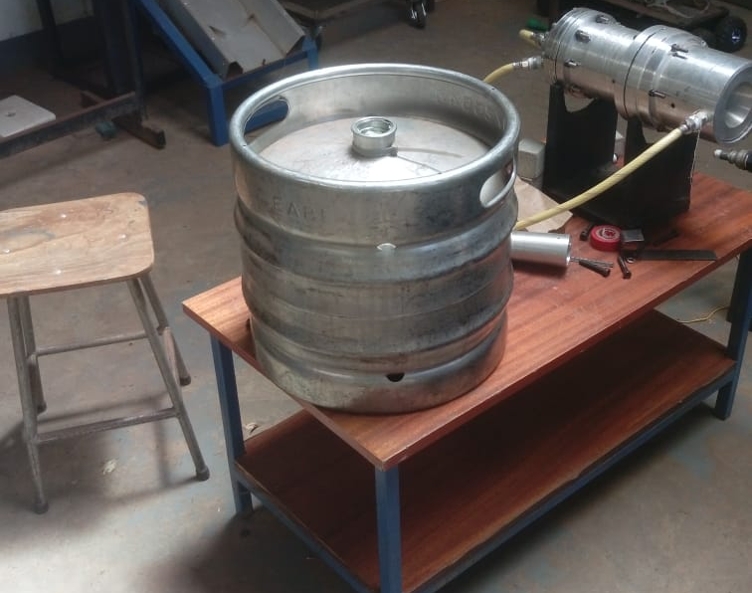
2. Fuel Tank
304 Stainless steel
30L fuel tank (as high as 8 tests)
We are to modify it with fittings (welding) to serve as our fuel tank

Slide 7
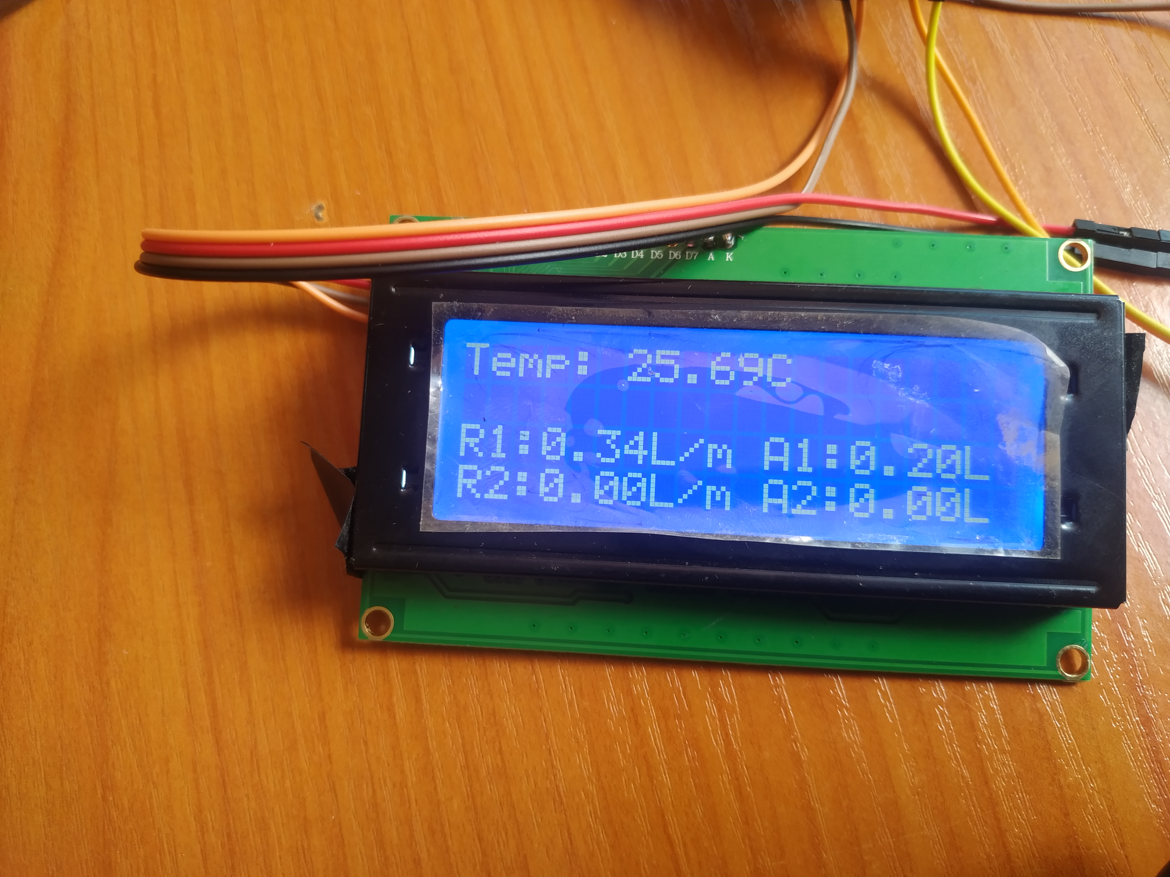
3. Display sensor values on UI
Our sensor data shall primarily be the database.
This UI shall help get quick visual readings on the actual setup.

Slide 8
Work in Progress
1. Acquire fittings and remaining components (piping, sensors)
2. Fabricate stand for fuel tank
3. Modify fuel tank using 2 fittings to serve our purposes
4. Finish and test complete code
5. Implement full circuit on perfboard

Slide 9
Thank you
Any Questions?

